Slide 1
Entity Resolution in Deep Learning
Mid-semester Progress Report
Presenters: Kailin Tang & Siyuan Xie

Slide 2
Background & Motivation
What is Entity Resolution (ER)?
Classic problem in data integration
Find records in a dataset that refer to same entity across different data sources
Why?
Heterogeneous data formats & sources
Errors during operations
Duplicated, incomplete and erroneous data
How?
Use ER to identify entities of same attribute, find and remove duplicated items

Slide 3
Challenges & Opportunities
Challenges
Heterogeneous & noisy data
Featuring engineering & relationship capture
Scalability
Human participation
Opportunities
Deep Learning in ER
Different deep learning model & structure
Different similarity vector calculation
Different blocking techniques
Notes:
Data labeling, feature engineering, block definition and etc.

Slide 4
Problem Definition
Input:
A target entity and a set of entities for matching
Output:
A set of matched tuples
Goal:
Explore deep learning on entity resolution to improve the performance

Slide 5

Problem Definition - Example
Whether two tuples in different databases refer to same item?
Buy_ID: 10346525
Name: Linksys G Wireless-G WET54G Wireless Bridge
Description: 54Mbps - 1 x 10/100Base-TX
Abt_ID: 33377
Name: Linksys Wireless-G Ethernet Bridge - WET54G
Description: Linksys Wireless-G Ethernet Bridge - WET54G/ Converts Wired-Ethernet Devices To Wireless-G Network Connectivity/ For Windows, Macintosh, Linux, PlayStation Consoles, Xbox Consoles, Or Anything With An Ethernet Port/ Plug And Play, No Driver Installation Require
Buy_ID: 10343605
Name: Linksys Instant Gigabit EG005W Ethernet Switch
Description: Linksys EG005W Gigabit 5-Port Workgroup Switch

Slide 6
Dataset
Six datasets in products and citations
Dataset | #Tuples | #Matches | #Attrbutes
Abt-Best | 2173-1092 | 1081 | 5
Amazon-Google | 1363-3226 | 1300 | 5
Walmart-Amazon | 2554-22074 | 1154 | 17
DBLP-ACM | 2616-2294 | 2224 | 4
DBLP-Scholar | 2616-64263 | 5347 | 4
DBLP-Citeseer | 1823978-2512927 | 558787 | 4

Slide 7
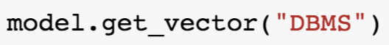
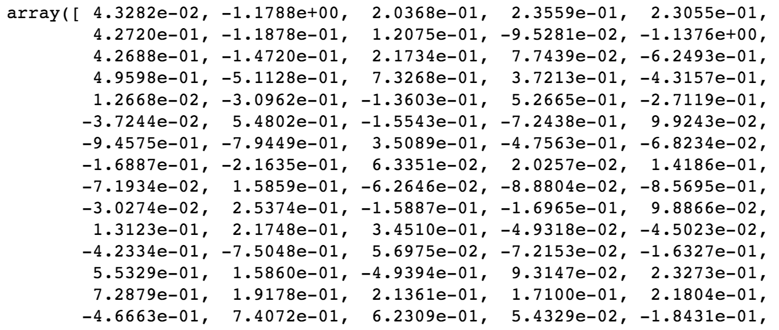
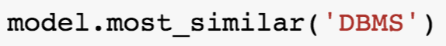
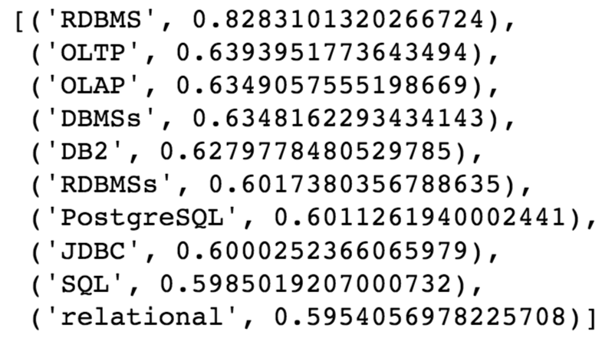
Approaches - Word Embedding
Representative Embedding
Word2vec
Predictive
Glove
Count-based
Word2vec -> Tuple2vec

Slide 8
Approaches - Distance Based Matching
Given a tuple vector in set A, find its closest vector in set B, check match or not.
# Nearest Neighbors | Euclidean Distance | Cosine Distance
1-NN | 0.272895467160037 | 0.2738205365402405
2-NN | 0.37650323774283073 | 0.3820536540240518
5-NN | 0.513413506012951 | 0.5541165587419057
20-NN | 0.7058279370952821 | 0.757631822386679
100-NN | 0.8482886216466234 | 0.9204440333024977
We can do something to reduce the search space!

Slide 9
Approaches - Classification Models
Given a combination of two tuple vector, judge whether they are matching.
Explore on several classic models
Logistic Regression
K-Nearest Neighbor
Decision Tree
Random Forest
Gradient Boosting
Support Vector Machine
Deep Neural Network
Tuple Vec-1
Tuple Vec-2
Mixer
Classification Model
MATCH
NOT MATCH

Slide 10
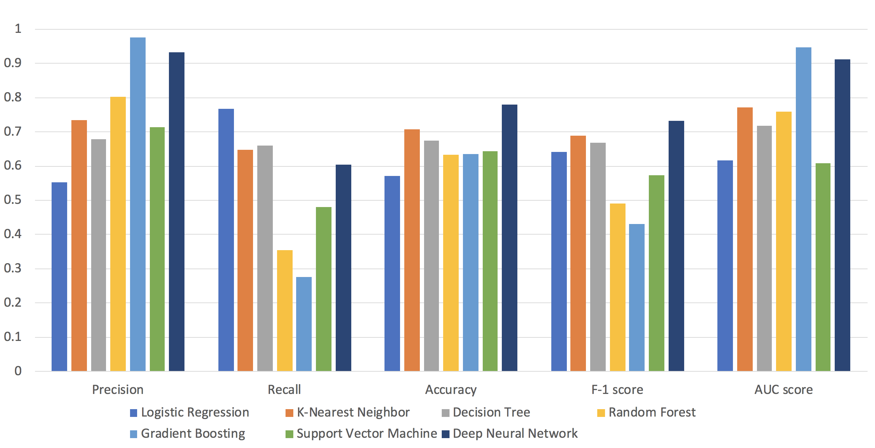
Approaches - Classification Models Results

Slide 11
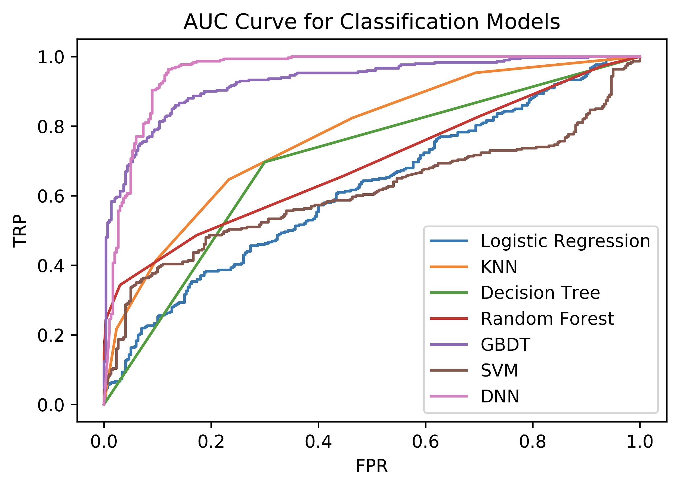
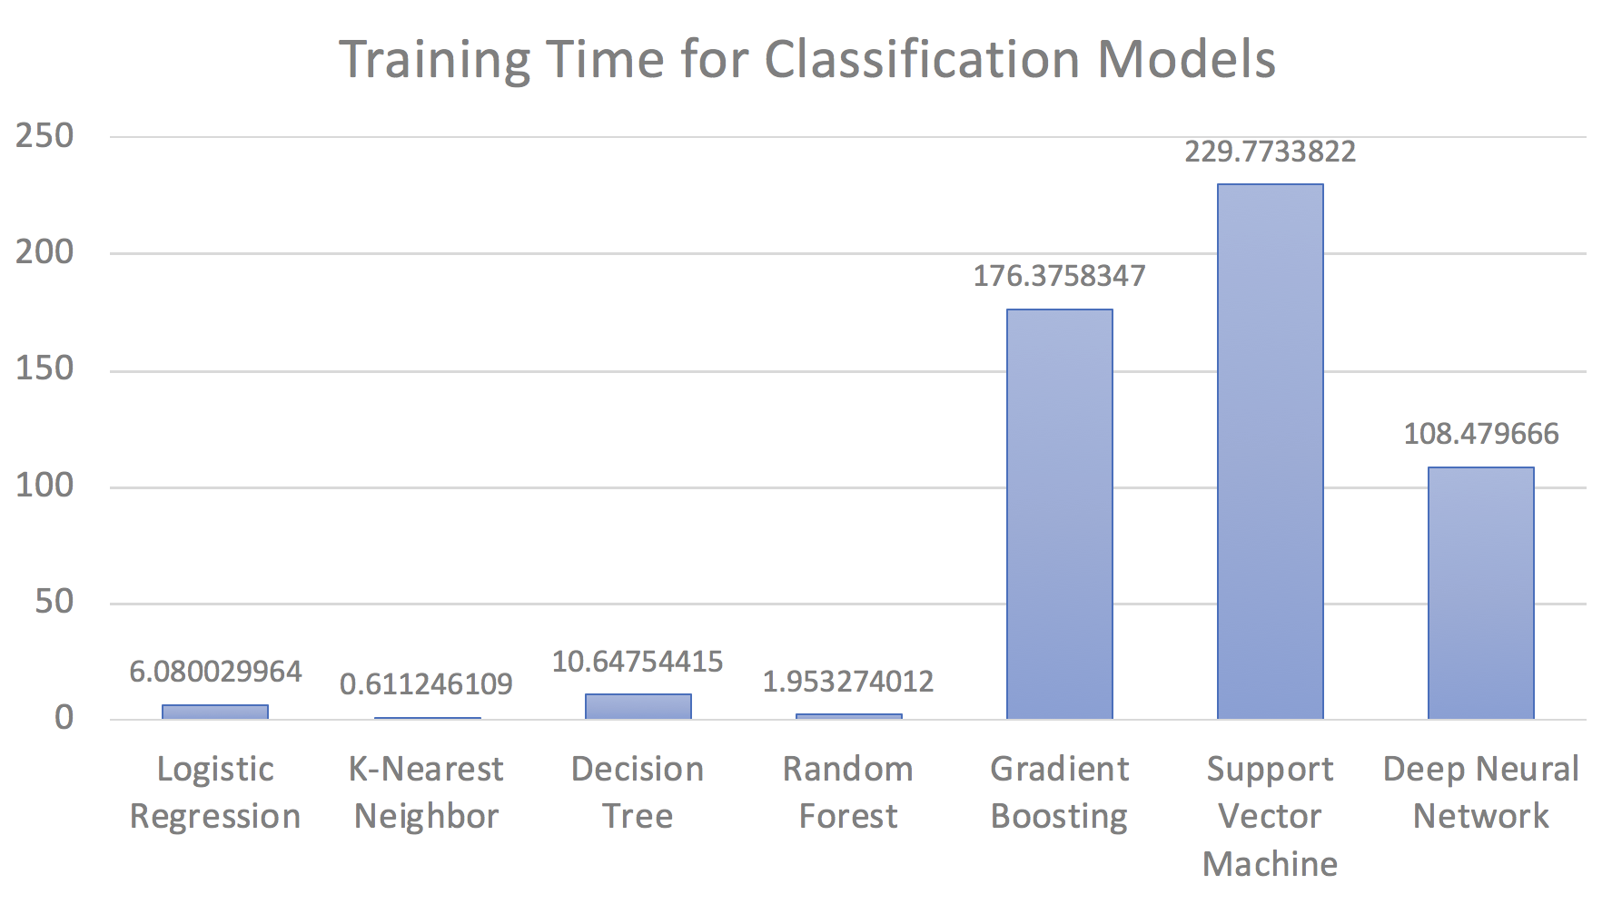
Approaches - Classification Models Results
DNN outperforms other models with moderate training time!

Slide 12
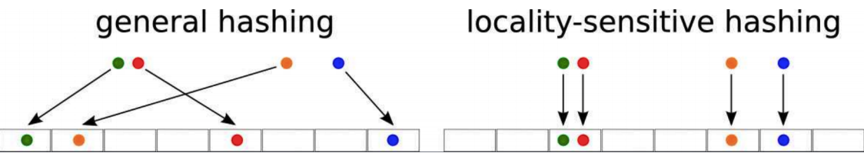
Approaches - Locality Sensitive Hashing(LSH)
It’s not efficient to compare all the entities when we have massive data
Blocking: filter out unnecessary comparisons with tuples
Locality Sensitive Hashing: similar tuples will have similar hash code.

Slide 13
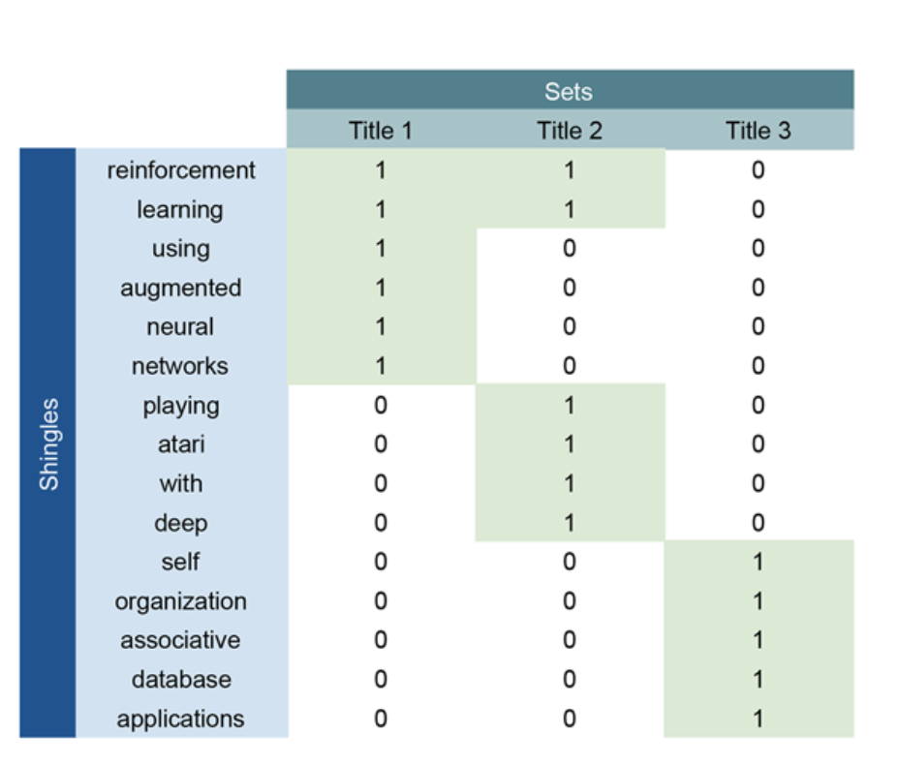

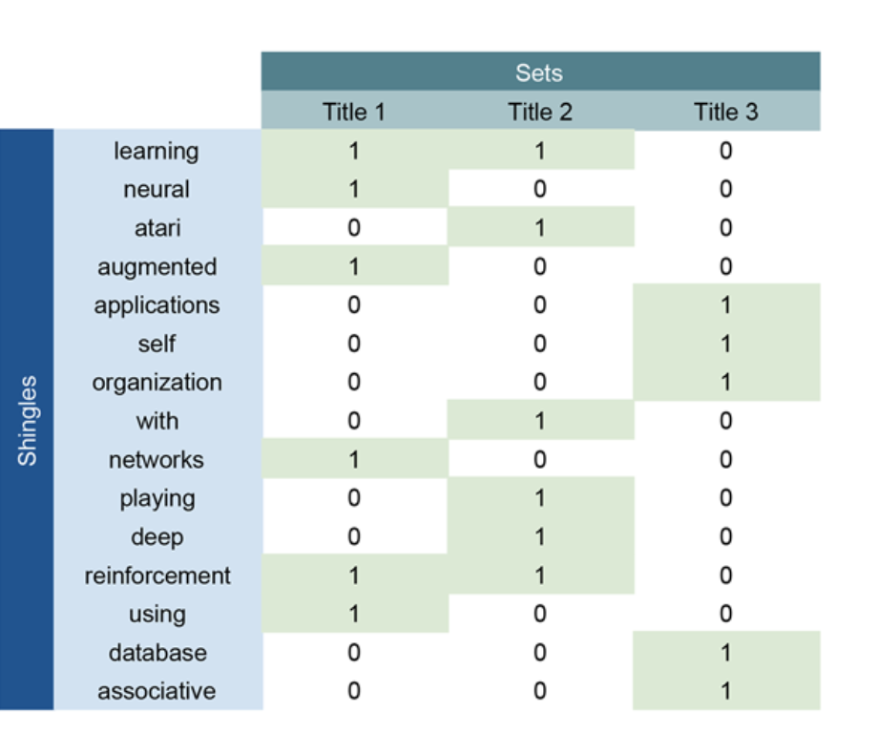
Example - minHash
sample
sample
feature
hash value
the hash value is the row number where we find the first 1
we change the permutation of features here
In minHash, probability[hash[A]=hash[B]] = Jaccard similarity[A,B]

Slide 14
Approaches - Local Sensitive Hashing(LSH)
time complexity:
Model Build:
KNN: O(n^2)
LSH: O(n)
Experiments on Abt-Buy datasets:
Build a KNN model:
7 seconds for Euclidean distance
88 seconds for cosine similarity
Build LSH forest:
5.9 seconds for Jaccard similarity
number of comparisons decreases while still maintain the accuracy
Query:
KNN: O(n)
LSH: O(p), p = number of permutations

Slide 15
Conclusion
Word embedding works for entity matching
Distance based matching works bad but useful for reducing the search space
DNN with naïve Tuple2vec works fine but still have space to improve
Locality sensitive hashing make it more efficient for massive data

Slide 16
Next Step
Explore more word embedding methods
Word2vec, FastText
Design CNN and RNN models for advanced tuple representation (Tuple2vec++)
Explore better similarity vector generation methods
Explore more blocking techniques
Neighbor sensitive hashing
Unsupervised clustering
Evaluate performance on all collected datasets

Slide 17
Reference
[1] Wikipedia: Word embedding, https://en.wikipedia.org/wiki/Word_embedding
[2] Mikolov, T., Chen, K., Corrado, G., Dean, J.: Efficient Estimation of Word Representations in Vector Space. At: http://arxiv.org/abs/1301.3781 (2013)
[3] Sidharth Mudgal, Han Li, Theodoros Rekatsinas. Deep Learning for Entity Matching: A Design Space Exploration. In SIGMOD’18: 2018 International Conference on Management of Data, June 10–15, 2018, Houston, TX, USA. ACM, New York, NY, USA, 16 pages. https://doi.org/10.1145/3183713.3196926
[4] Benchmark datasets for entity resolution - database group at the University of Leipzig, https://dbs.uni-leipzig.de/en/research/projects/object_matching/fever/benchmark_datasets_for_entity_resolution
[5] S. Das, A. Doan, P. S. G. C., C. Gokhale, and P. Konda. The magellan data repository. https://sites.google.com/site/anhaidgroup/useful-stuff/data
[6] Matthew Francis-Landau et al. 2016. Capturing semantic similarity for entity linking with convolutional neural networks. CoRR abs/1604.00734 (2016).
[7] Muhammad Ebraheem, Saravanan Thirumuruganathan, Shafiq Joty, Mourad Ouzzani, and Nan Tang. Distributed Representations of Tuples for Entity Resolution. PVLDB, 11 (11): 1454-1467, 2018.
[8] H. L. Dunn. Record linkage. American Journal of Public Health, 36 (12), 1946.
[9] Kooli et al., ACIIDS’18. Deep Learning Based Approach for Entity Resolution in Databases
[10] Kim Y. Convolutional neural networks for sentence classification[J]. arXiv preprint
arXiv:1408.5882, 2014.
[11] Kalchbrenner N, Grefenstette E, Blunsom P. A convolutional neural network for modelling sentences[J]. arXiv preprint arXiv:1404.2188, 2014.
[12] Hu B, Lu Z, Li H, et al. Convolutional neural network architectures for matching natural language sentences[C]//Advances in Neural Information Processing Systems. 2014: 2042-2050.
[13] R. Baxter, P. Christen, and T. Churches. A comparison of fast blocking methods for record linkage. In SIGKDD Workshop on Data Cleaning, Record Linkage, and Object Consolidation, 2003.
[14] Park, Y., Cafarella, M., & Mozafari, B. (2015). Neighbor-sensitive hashing. Proceedings of the VLDB Endowment, 9(3), 144-155.

